Slide 1
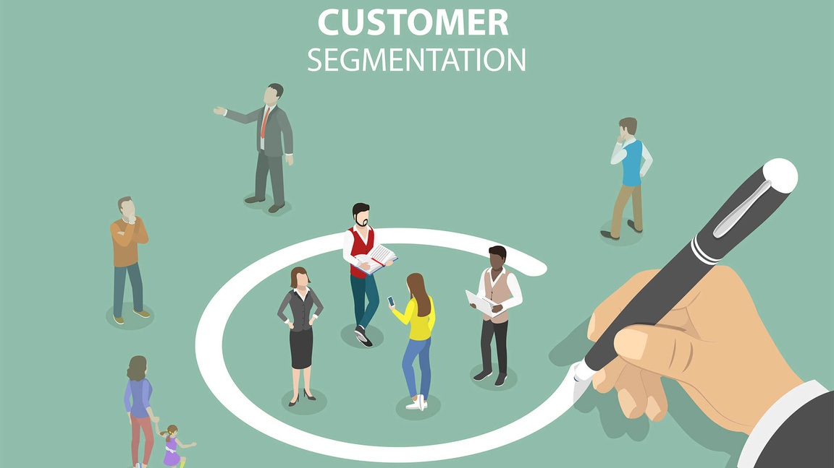
CUSTOMER SEGMENTATION
COMPANY PRESENTATION

Slide 2
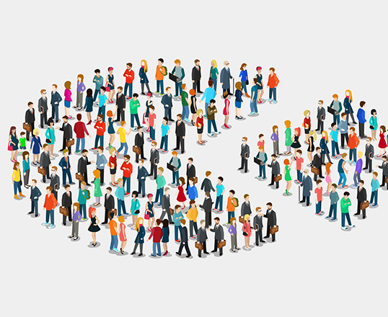
INTRODUCTION
• Customer segmentation is done to divide customers into different groups having similar characteristics
• By doing so we can identify the most and least profitable customers
• Build loyal relationships with customers
• Maximize the use of resources
• Improve products to meet customer requirements

Slide 3

OBJECTIVES
•To divide customers into different groups based on their annual income, spending score, age group they belong to, and spending behavior.
•So that we customize marketing strategies uniquely for different segments which will increase the effectiveness of marketing.
•And to offer services and products based on their segment characteristics.

Slide 4
METHODOLOGY
1. Data Preprocessing:
Clean and structure the mall customer data, handling missing values and outliers to ensure accurate analysis.
2. Exploratory Analysis:
Use Python to visualize and summarize the data, gaining insights into customer demographics, spending patterns, and behaviors.
3. Feature Selection:
Choose relevant attributes for segmentation, considering factors like age, income, and purchase history.
4. Scaling Features:
Normalize or scale selected features to ensure fair contribution to the clustering process.
5. K-Means Clustering:
Implement K-means using sci-kit-learn, grouping customers into distinct clusters based on similarities.
6. Optimal Cluster Count:
Utilize the elbow method in Python to determine the optimal number of clusters (K) for the data.
7. Cluster Evaluation:
Assess cluster quality using metrics like silhouette score to ensure meaningful segmentations.
8. Cluster Visualization:
Visualize clusters and centroids using plots for easy interpretation.
9. Customer Profiling:
Analyze attributes within each cluster to create detailed customer profiles.
10. Strategy Formulation:
Develop tailored strategies for each segment based on customer profiles and behaviors.

Slide 5
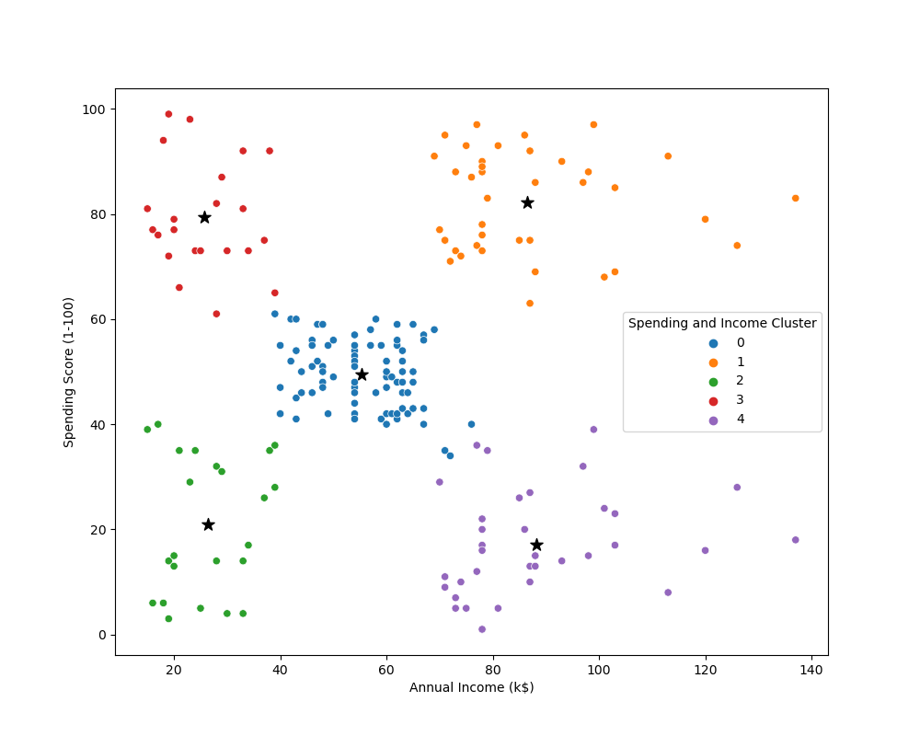
POTENTIAL SEGMENTS
Cluster 0
Moderate Annual Income, Moderate Spending Score
Cluster 1
High Annual Income, High Spending Score
Cluster 2
Low Annual Income, Low Spending Score
Cluster 3
Low Annual Income, High Spending Score
Cluster 4
High Annual Income, Low Spending Score

Slide 6
CUSTOMER SEGMENT 0
Customers of this segment have moderate annual income and moderate spending scores
Formed by 60% female and 40% male
The average age of 42 years
We will call this segment the mediocre’s

Slide 7
CUSTOMER SEGMENT 1
Customers of this segment have high annual income and high spending scores
Formed by 53% female and 47% male
The average age of 32 years
We will call this segment the affluent group

Slide 8
CUSTOMER SEGMENT 2
Customers of this segment have low annual income and low spending scores
Formed by 60% female and 40% male
The average age of 45 years
We will call this segment the cheapskates

Slide 9
CUSTOMER SEGMENT 3
Customers of this segment have low annual income and high spending scores
Formed by 60% female and 40% male
The average age of 25 years
We will call this segment the big-hearted group

Slide 10
CUSTOMER SEGMENT 4
Customers of this segment have high annual income and low spending scores
Formed by 46% female and 54% male
The average age of 41 years
We will call this segment the savers

Slide 11
THANK YOU
Dhruv Padariya

